Slide 1
Machine Learning Fundamentals
Ryan Walbridge
2018/12/14

Slide 2
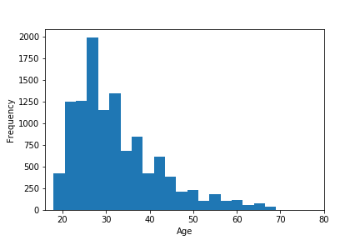
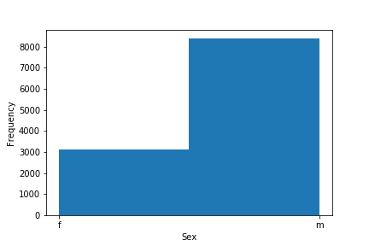
Graphs of Data

Slide 3
Statement/Questions
Predict orientation based on income level?
Does orientation affect how much a person is paid?
Guess pet “status” based on income and orientation?
Does income and sexual orientation affect whether a person own/likes/dislikes pets/animals?

Slide 4
Added Data Columns
Added a column for sex mapping using the following:
  "m": 0, "f": 1
Added a column for income mapping with less categories using the following:
  20-40k, 50-99k, 100-499k, 500+k
Added a column for pet mapping with less categories using the following:
  #0: dislikes pets, #1: likes pets does not have, #2: Like one not the other, #3: Owns one but dislikes other, #4: Owns one likes other, #5: owns 1, #6: has both
Added a column for orientation mapping using the following:
  "straight": 0, "gay": 1, "bisexual": 2

Slide 5
MLR/KNR Comparison
Predict orientation based on income level?
Multiple Linear Regression
Fit Time: 0.0s
Accuracy: 0.014995
K-Neighbors Regressor
Fit Time: 0.578492s
Accuracy: -0.234118

Slide 6
K-NB/SVM Comparison
Guess pet “status based on income and orientation?
K-Nearest Neighbors
Fit Time: 0.023939s
Accuracy: 0.324061
Precision: 0.24
Recall: 0.32
F1-Score: 0.27
Support Vector Machines
Fit Time: 2.279284s
Accuracy: 0.412378
Precision: 0.17
Recall: 0.41
F1-Score: 0.24

Slide 7
Conclusion
Question: Predict orientation based on income level?
Question: Guess pet “status based on income and orientation?
Based on my test and results I was not able to predict the outcome of either question. Maybe I need to add more information to help with decision making or maybe there is no correlation between orientation and income and in the second case orientation, income and pet status.

